Slide 1

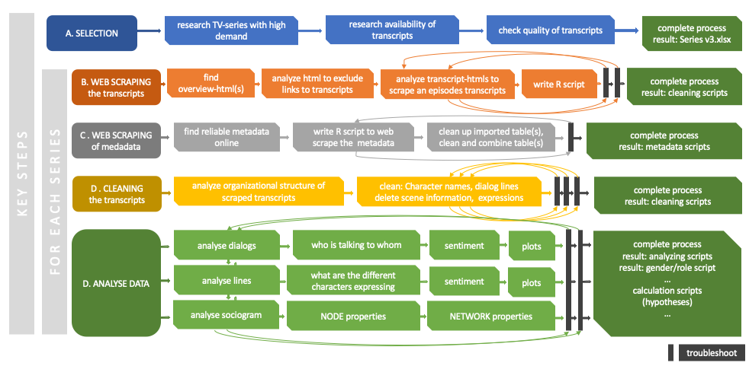
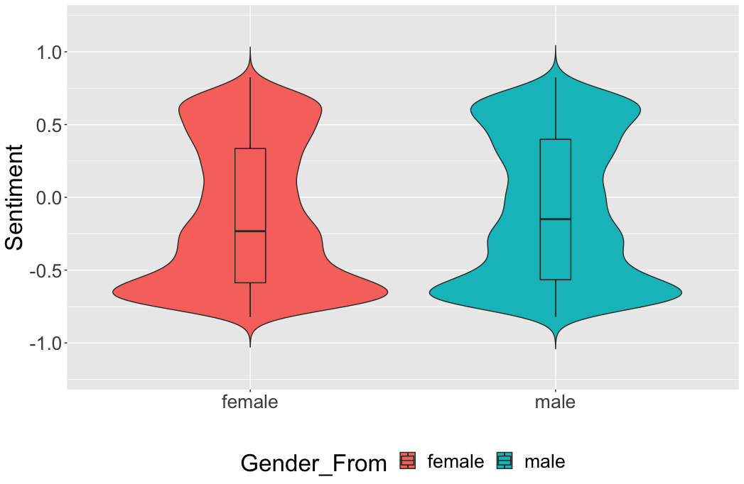

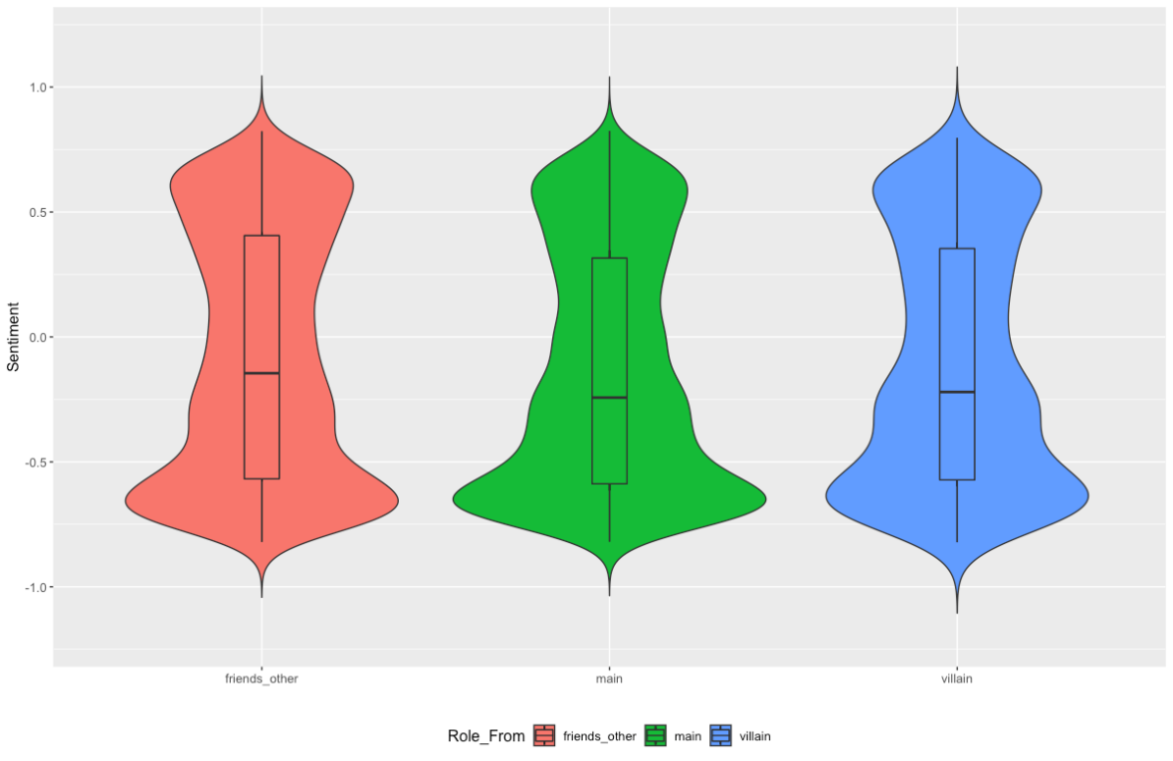
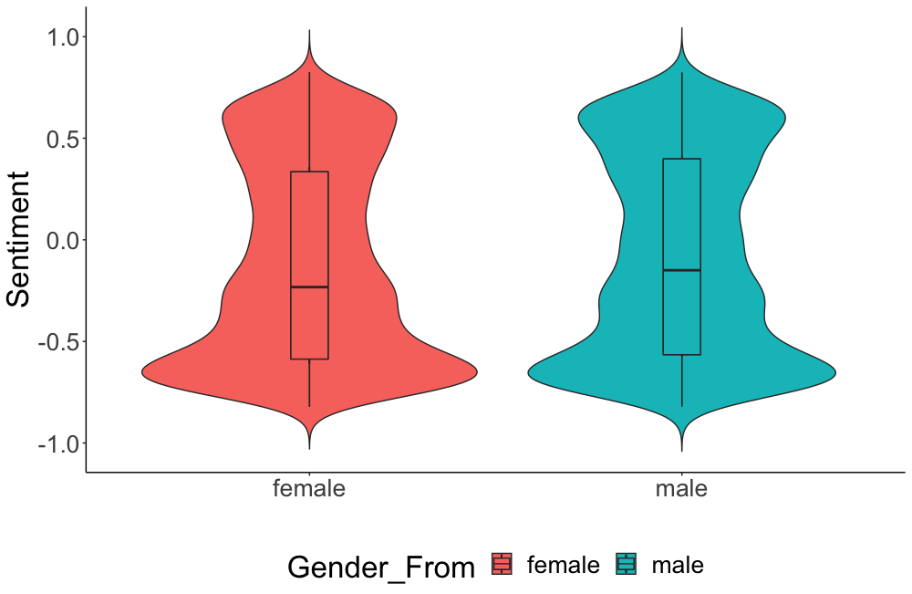
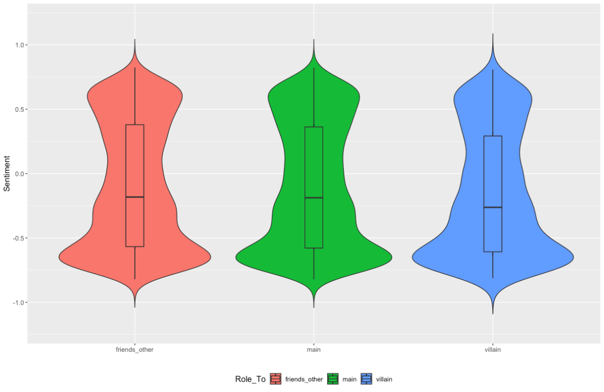
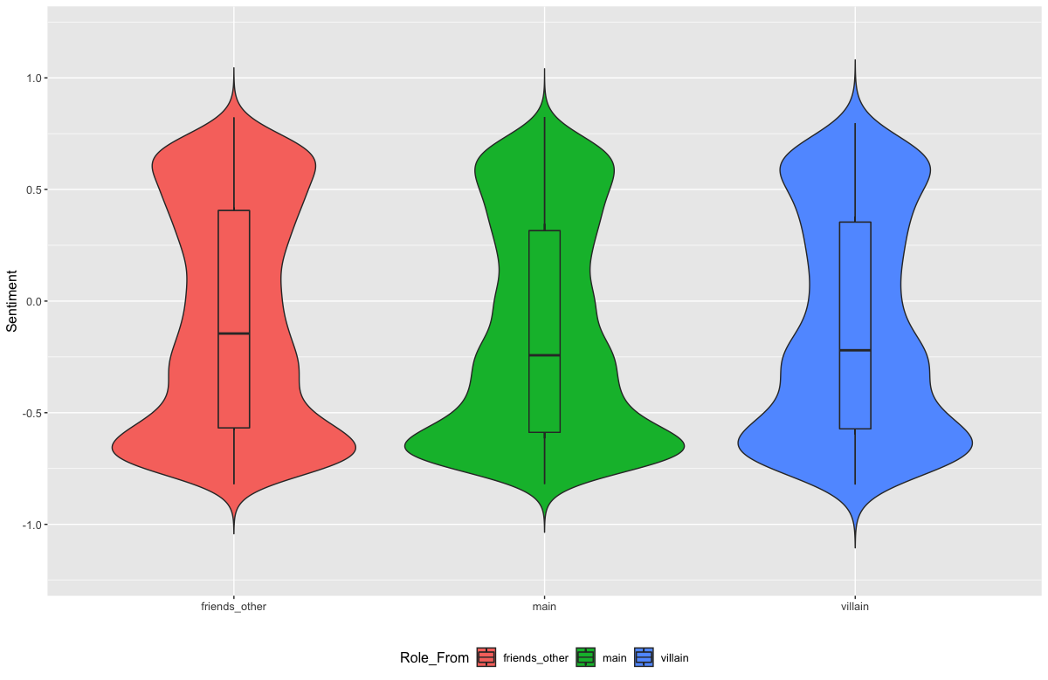
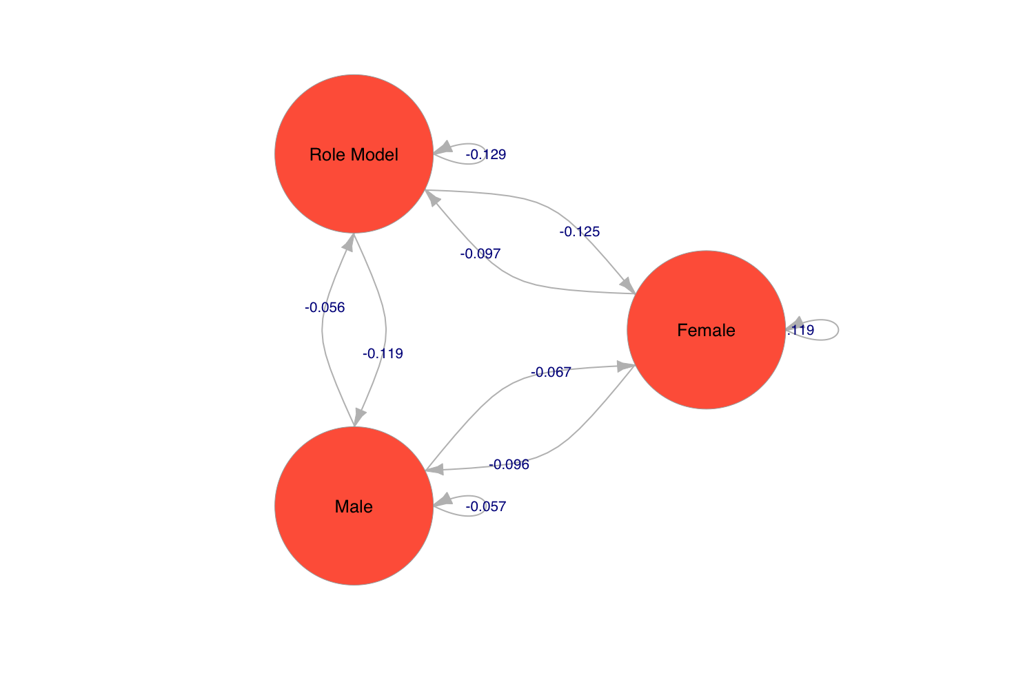
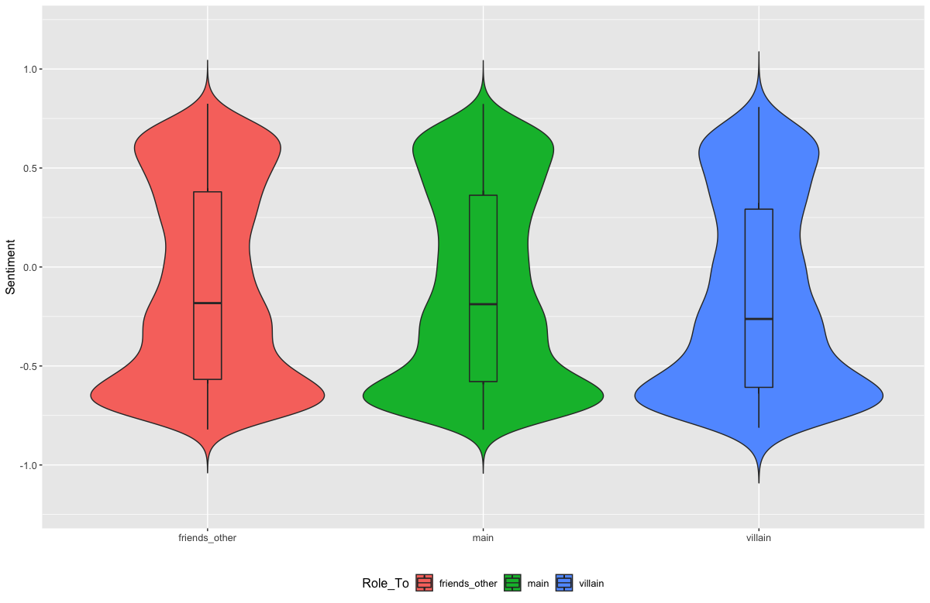
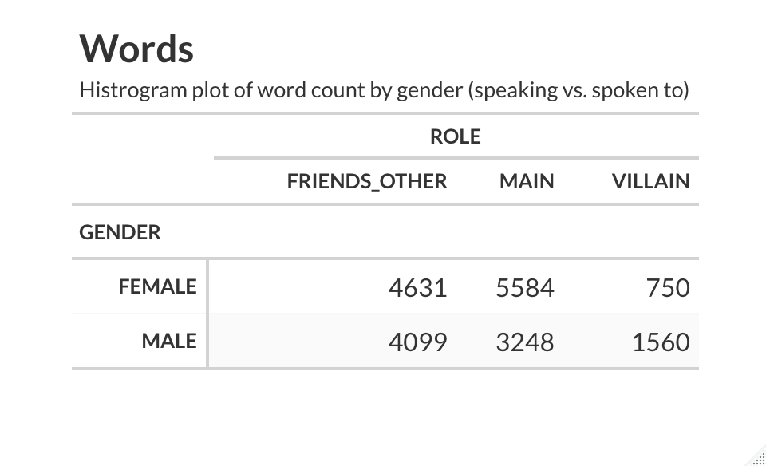
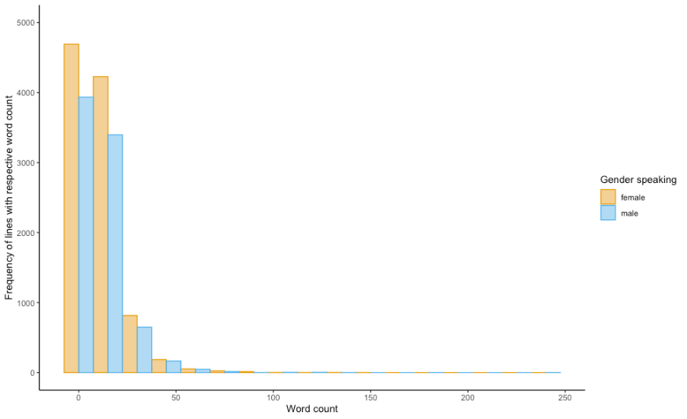
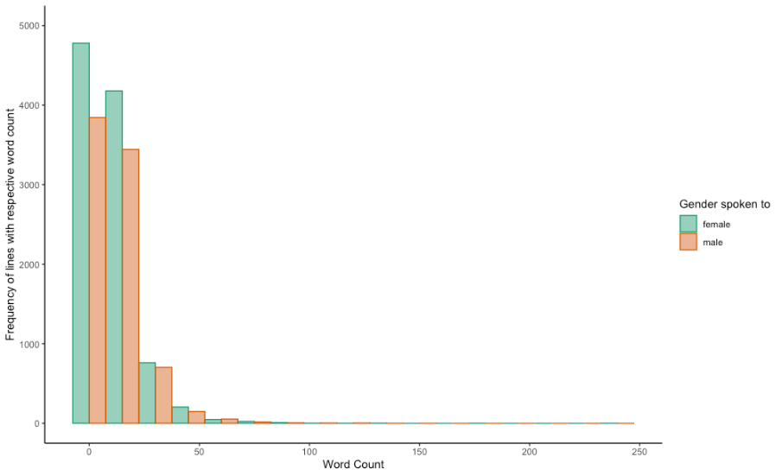

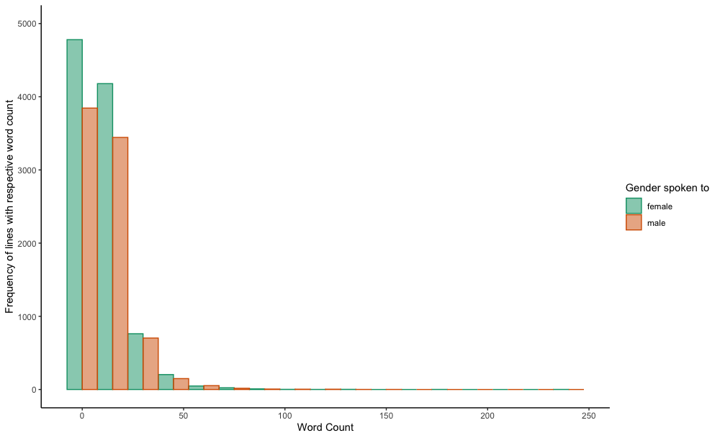
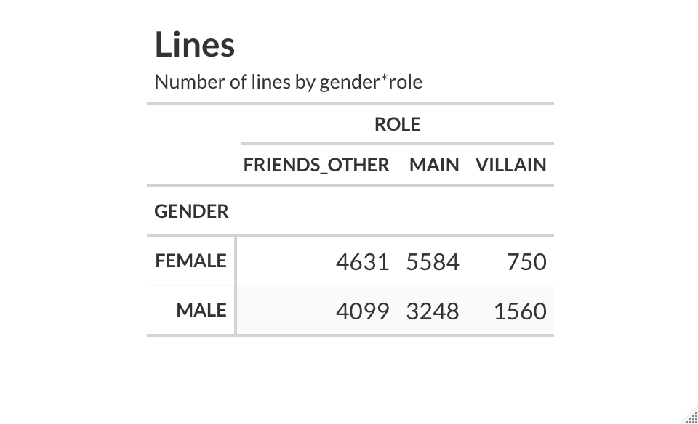
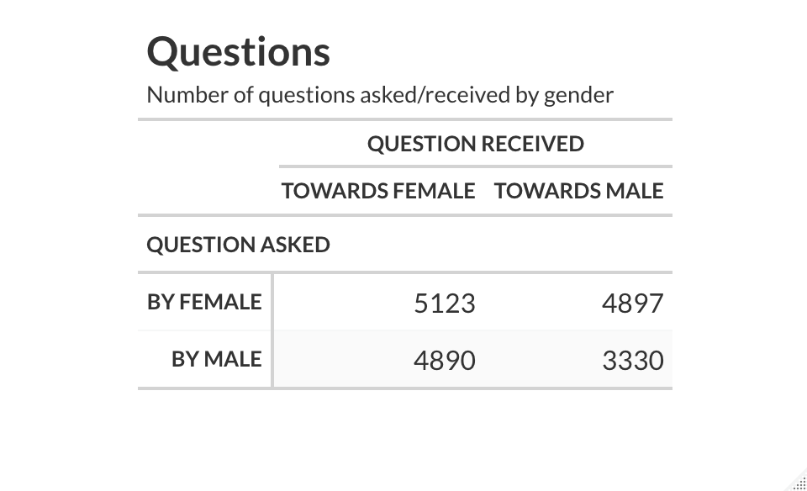
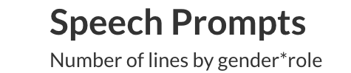
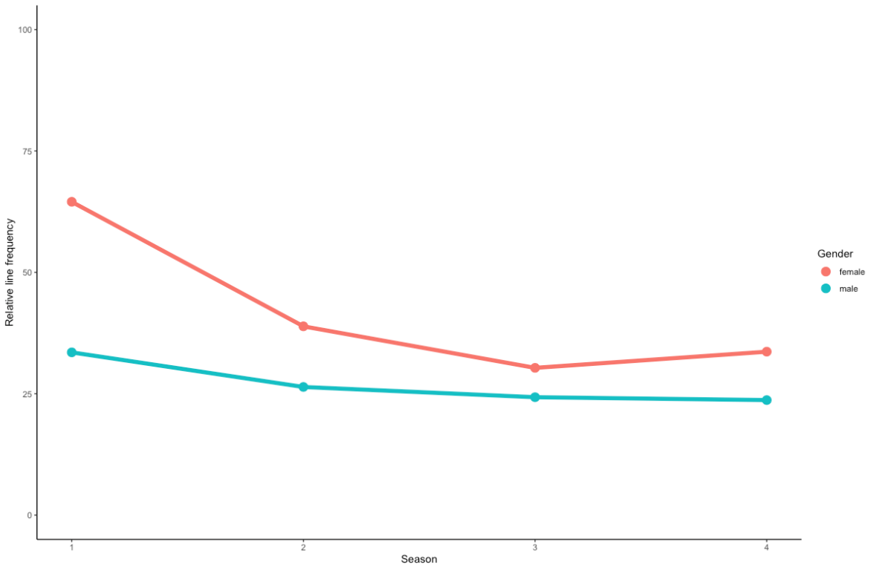
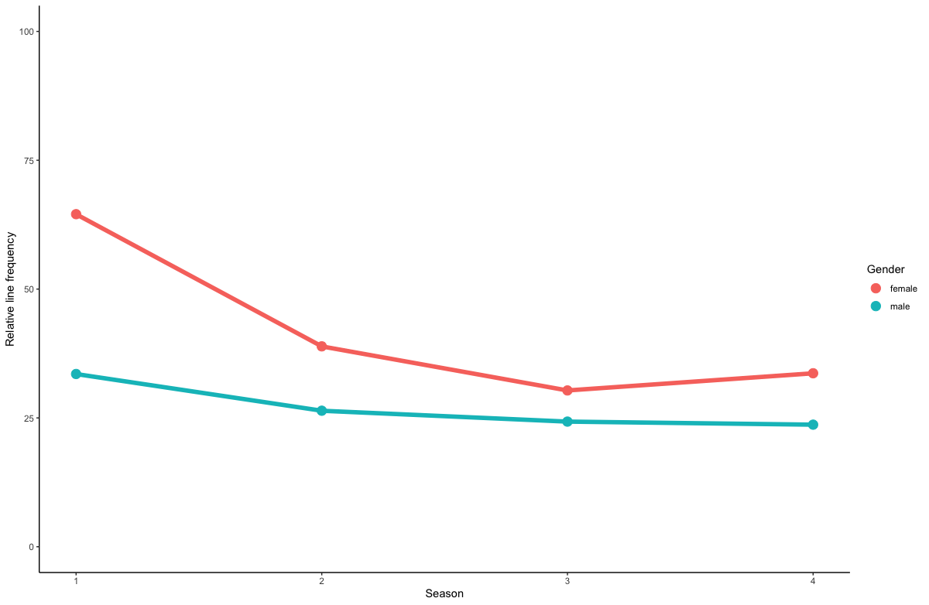
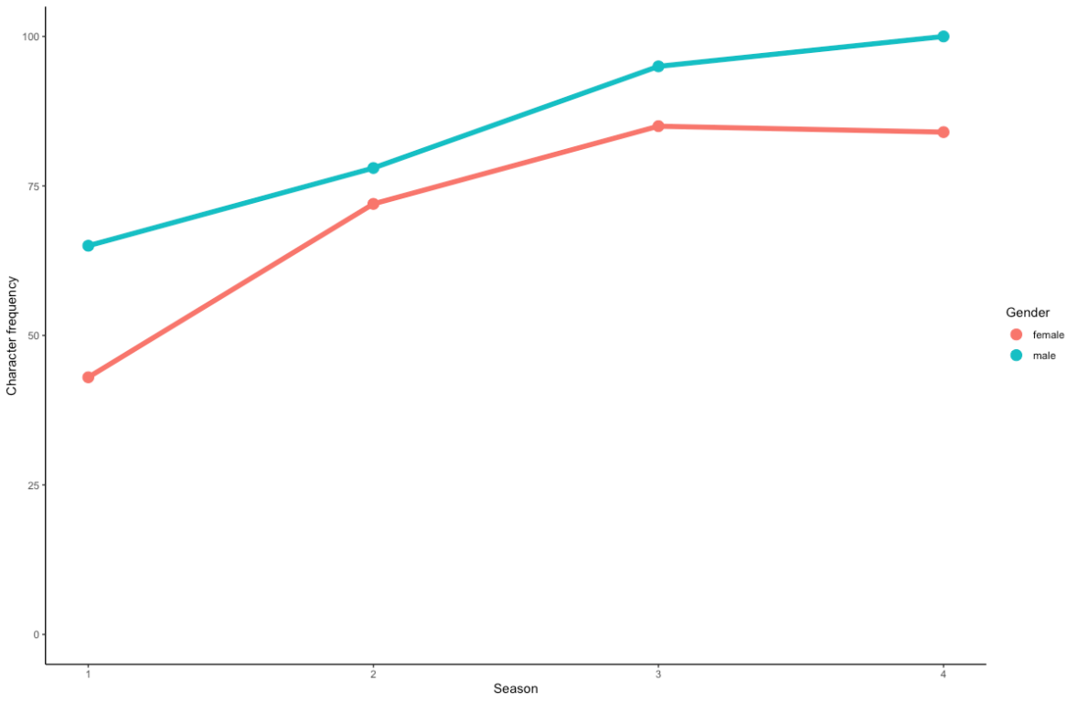



Gender biases in animated series for children – a network analysis
Martin Faschingbauer^{1*}, Supervisor: Guilherme Wood¹
¹University of Graz
Introduction
In Albert Banduras Social-Cognitive-Theory children are learning social behaviour mostly through observation of others and the social consequences associated with it. These implications are also true when children are observing behaviour through a television program^{[4,6]}. The occurrence of gender biases in mass media, especially in television has been well documented throughout different fields of research. Gender stereotypes are widely spread in media in general, and in TV shows for children in particular.
Often male characters outnumber female characters by 2:1^{[2,3]}. They appear on screen more often, speak more words, ask more questions and have more questions directed towards them compared to female character ^{[5]}.
Study Aim: The aim of this explorative research study was to investigate the occurrence of gender specific properties in popular animated series by analysing the corresponding transcripts using computational techniques.
Figure 1: Research process workflow incl. step descriptions and resulting workflow artifacts.
Table 1: Hypotheses and applied statistical methods
Hypothesis | Research Question
H1 | A difference in the sentiment-scores (s-scores) of characters expressions depending on their gender as well as that of the addressees is expected. proc.: 2-way & 4-way ANOVA; gender_from*gender_to (2x2) & …*role_from*role_to (2x2x4x4)
H2 | A difference in the sentiment scores of potential role models (ten most central characters by betweenness) is expected depending on the gender of the character they are talking to or the gender of the character talking to them. proc.: 2-way ANOVA; from*to (3x3)
H3 | It is expected that the following text parameters will differ depending on the gender of the character and that of the addressees: 3a: number of characters by gender; proc.: χ² Test of Independence; characters by gender (2) 3b: number of speech prompts; proc.: χ² Test of Independence; lines by Gender (2x2) 3c: number of words spoken; proc.: three-way ANOVA; gender_from*gender_to*wCount 3d: number of questions; proc.: three-way ANOVA; gender_from*gender_to*question (2x2x2) χ² Test of Independence; question by gender_from*gender_to (2x2)
Methods
Sample: 131 open-source transcripts of the animated series ”Miraculous: Tales of Ladybug & Cat Noir“ by Zagtoon, 27 transcripts had to be excluded, so 104 were analysed. Processing and calculation: After web-scrapping the data and a complex cleaning process, sentiment analysis was performed per paragraph using sentiment.ai^{[9]}. The steps of transcript processing are shown in detail in Figure 1. Since the sentiment data was not normally distributed, it was z-transformed before further analyses. Graph-characteristics were used to examine social properties within the series^{[1]}. Table 1 lists the study hypotheses and the calculation methods used. All computations were conduced exclusively using R Studio (2022.02.1 Build 46) and selected packages^{[7,8,9]}.
Results & Discussion
[H1] Expressions by female characters are sign. more negative in sentiment than those by males (F(1) = [41.022], p < 0.001; Figure 2). No sign. effects in S-scores in gender groups of the addressees were observed. No interaction effect between the factors was observed either. ANOVA model-fit analysis suggested a four-way ANOVA adding role_from*role_to as additional independent variables over the described two-way ANOVA, showing sign. main effects in gender_from, role_from and role_to as well as 42 sig. interaction-effects (gender_from see above; role_from: F(3) = [16.589], p < 0.001; role_to: F(3) = [9.541], p < 0.001; Figures 3 and 4).
[H2] Expressions of (potential) role models, female characters and male characters differ in mean S-scores (F(2) = [29.674], p < 0.001). Role models show the lowest S-scores, followed by females and males (Figure 5). No significant effects in S-scores in the addressees groups were observed, as well as no interaction-effect between the factors was observed either.
[H3] The number of characters by gender differ significantly overall as well as by season with the number of male characters being higher (χ² (NA, N = 371) = 4.6881, p < 0.05, see also plot B in Figure 6). The differences in speech prompts (spoken lines) grouped by gender are sign. between groups (χ² (NA, N = 19895) = 177.63, p < 0.001). Female characters speak more lines than males. When adding character roles - again all groups differ significantly (χ² (2, N = 19895) = 728.99, p < 0.001; Table 3). The number of questions asked as well as received per by gender differ in all groups. Female characters are asking more questions and are getting asked more more questions than males do (see Table 4). A three-way ANOVA adding the factor Question s an an independent variable to gender_from, gender_to shows no sign. effects except those those already orted. reported above (gender_from). No main- or interaction-effects (gender_from, gender_to) in number of words per per line were observed in S-scores, Frequency are shown in Table 2 for reasons of completeness.
[Overall] Mean group S-scores are negative in all generated subgroups (gender, role, role category).
Fig. 2: [H1a] Violin plot of S-scores - gender_from
****
Fig. 3: [H1b] Violin plot of S-scores - role_from
****
*
female male
Fig. 4: [H1b] Violin plot of S-scores - role_to
[H1b] Role_From
****
****
friends_other main villain
Fig. 5: [H2] S-scores – pot. role models and gender
friends_other main villain
*not sign. quoted for completeness
Tab. 2: [H3c] Words
Frequency
Frequency
Conclusion
Computational analysis of social structures in TV series can be carried out based on the dialogs within a series. The informative value of the analysis crucially depends on the quality of the transcripts.
The results of the study in terms of possible gender bias are limited to one animated series only and would need to be extended to a variety of series to increase the generality of conclusions.
Tab. 3: [H3b]: Speech Prompts (spoken lines)
Tab. 4: [H3d]: Questions
Word Count Word Count
Fig. 6: [H3a] Relative no. of lines by gender & season (A), no. of characters by gender & season (B)
100
75
50
25
0
A
100
75
50
25
0
B
Relative line frequency
Character frequency
[H1]
1 2 3 4
Season
1 2 3 4
Season
**** p > 0.0001 *** p > 0.001 ** p > 0.01 * p > 0.05
References
[1] Amestoy P. R. et al (2022). igraph: Network Analysis and Visualization. R package version 1.3.2.
[2] Aubrey, J. S., & Harrison, K. (2004). The Gender-Role Content of Children's Favorite Television Programs and Its Links to Their Gender-Related Perceptions. Media Psychology, 6(2), 111–146.
[3] Baker, K., & Raney, A. A. (2007). Equally super?: Gender-role stereotyping of superheroes in children’s animated programs. Mass Communication & Society, 10(1), 25-41.
[4] Bandura, A. (1965). Influence of models' reinforcement contingencies on the acquisition of imitative responses. Journal of Personality and Social Psychology, 1(6), 589–595.
[5] Biddle, A. M. (2017). Gender Stereotypes within TV shows for Preschoolers and their Effects on Children's Stereotypes, ProQuest Dissertations Publishing.
[6] Bussey, K., & Bandura, A. (1999). Social cognitive theory of gender development andd ifferentiation. Psychological Review, 106, 676-713.
[7] Revelle. E. (2022). psych: Procedures for Psychological, Psychometric, and Personality Research. R package version 2.2.5.
[8] Wickham H., Chang Ch., Henry L. (2022). ggplot2: Create Elegant Data Visualisations Using the Grammar of Graphics. R package version 3.3.6.
[9] Wiseman B., Nydick St., Wisner T., Lodge F., Wang Y.-A., Ge V. (2022). sentiment.ai: Simple Sentiment Analysis Using Deep Learning. R package version 0.1.1.
*Corresponding author: martin.faschingbauer@edu.uni-graz.at, psychology.uni-graz.at

